Slide 1




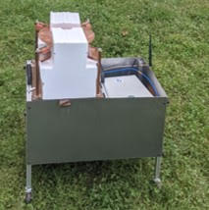
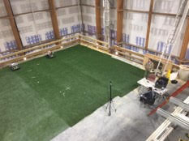
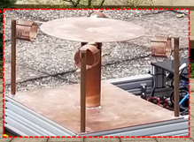

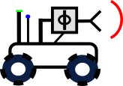
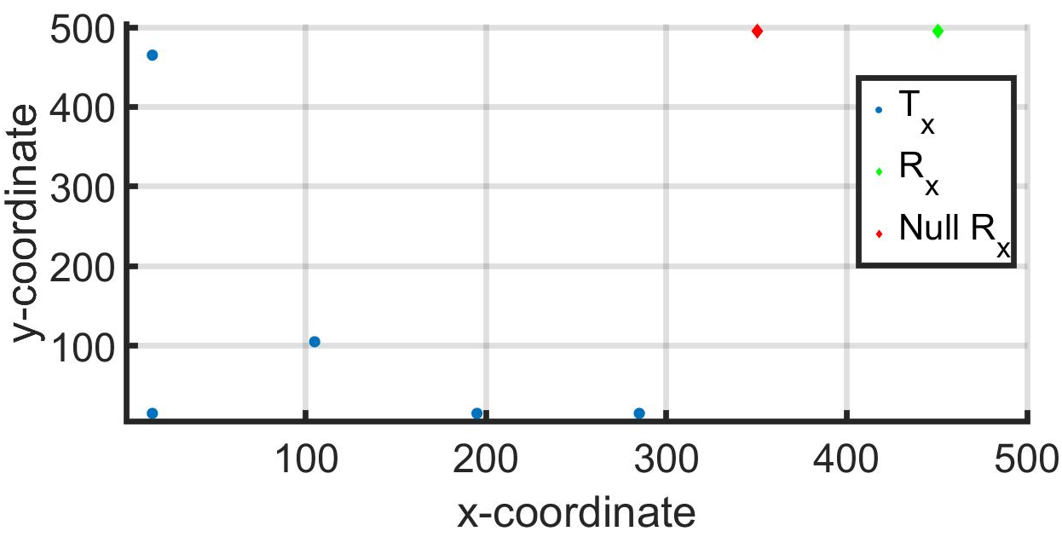
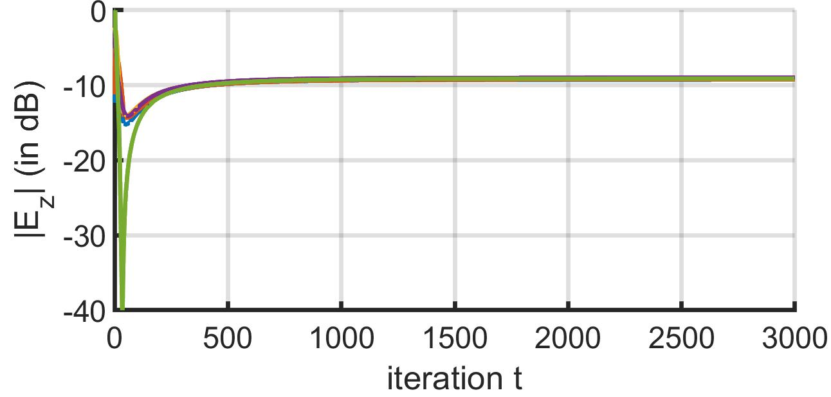
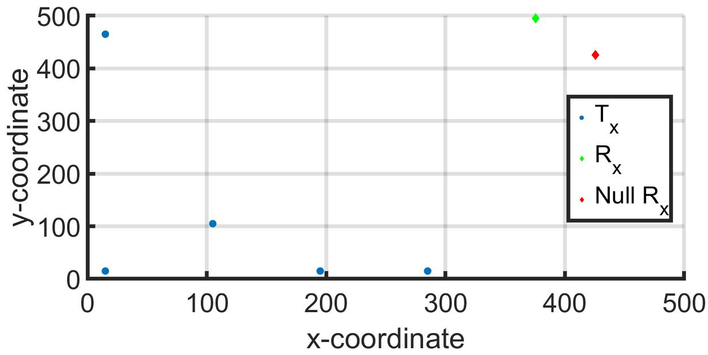
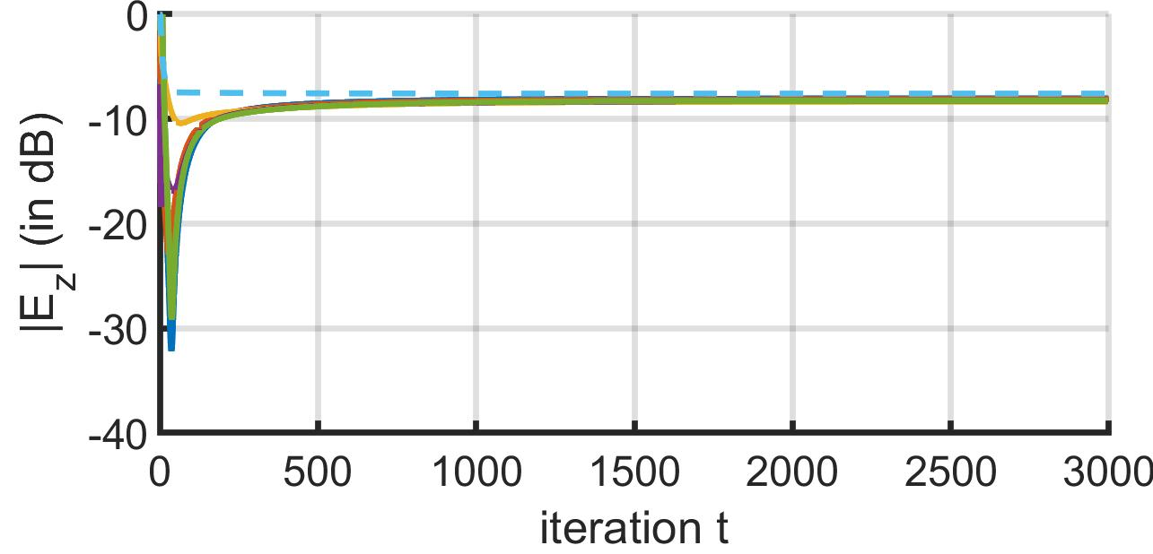
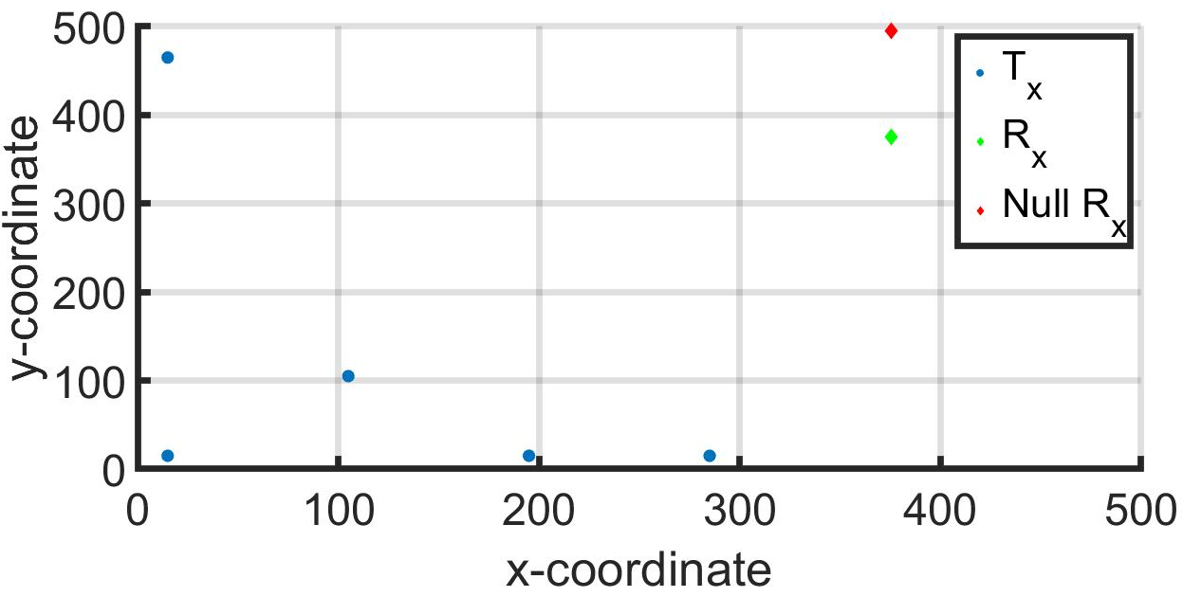
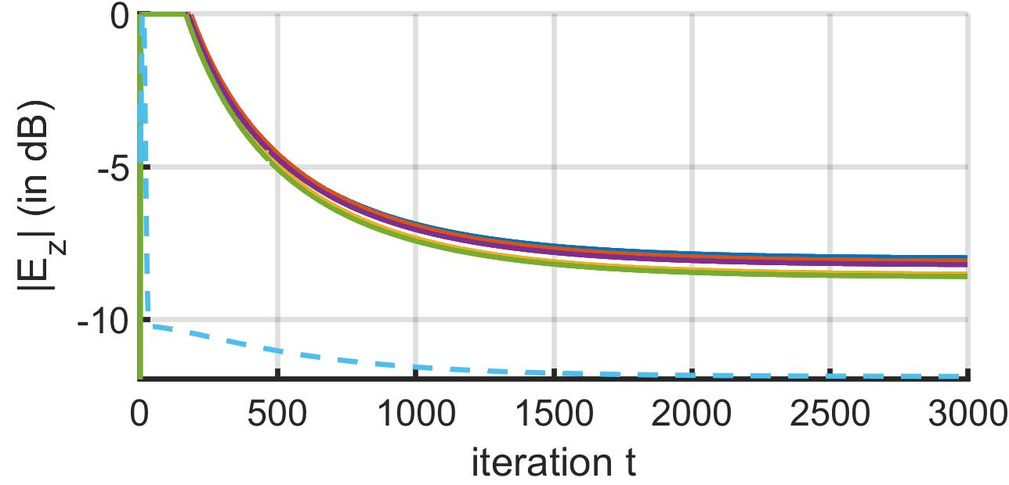

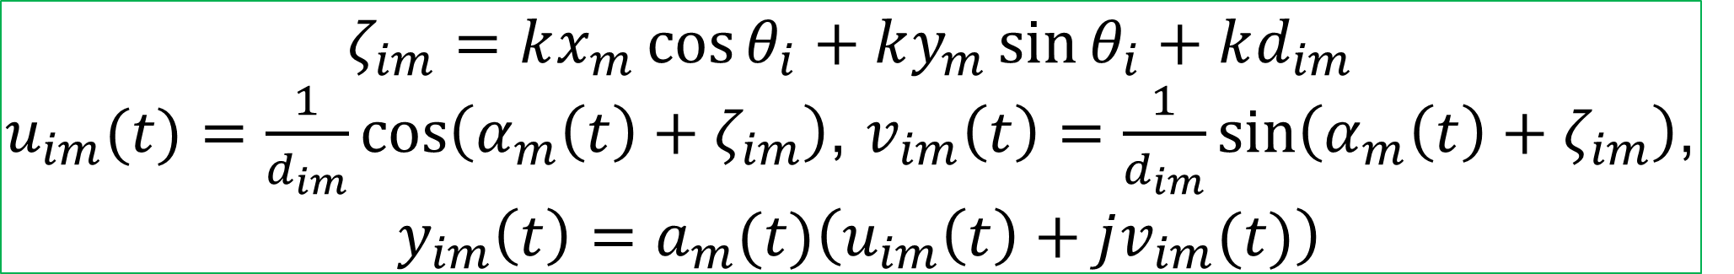
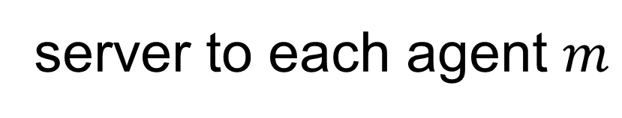
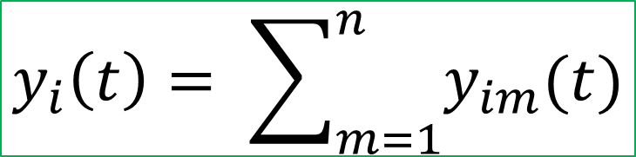


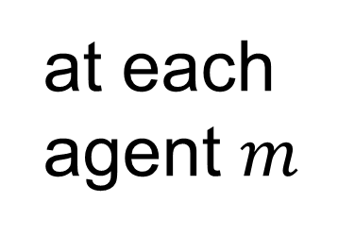
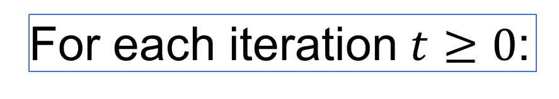
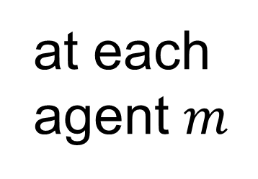
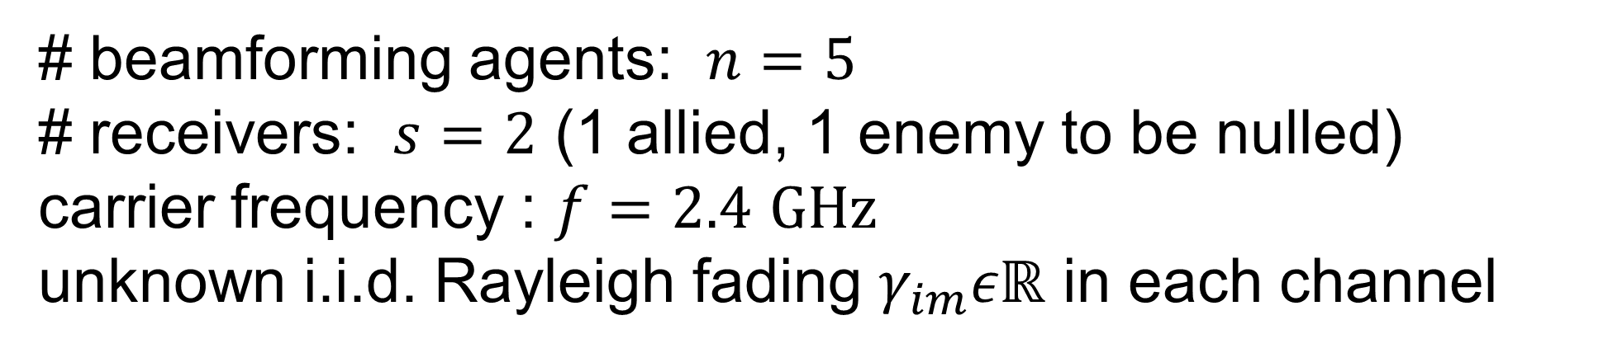
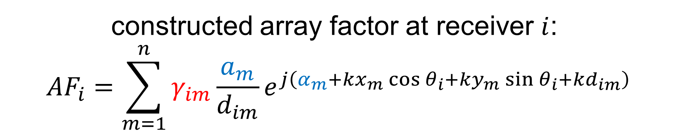

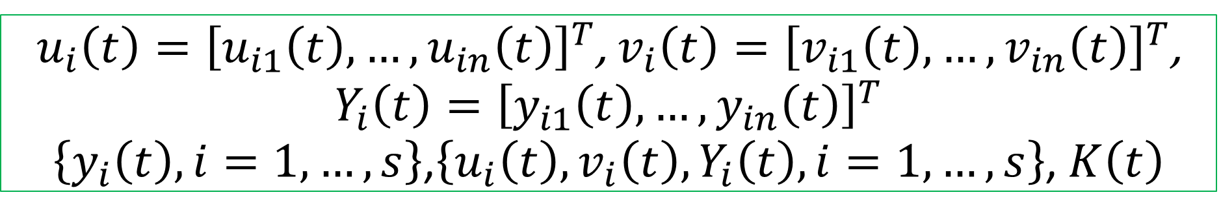
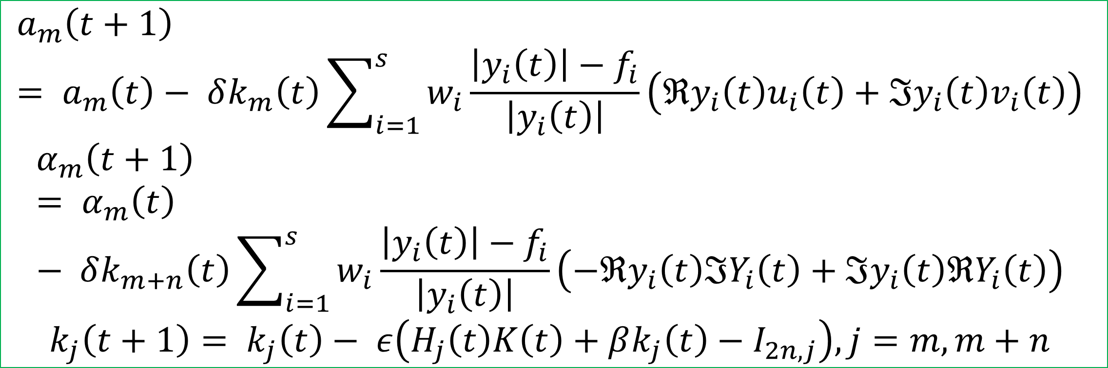

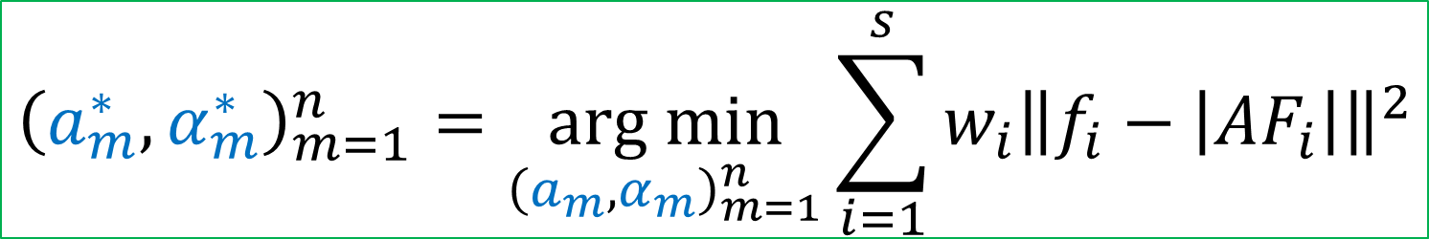
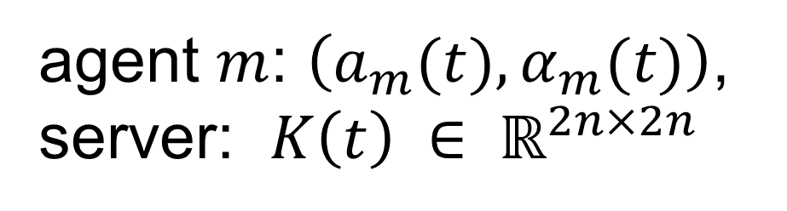


Project 1.6: Distributed Robotic Beamforming
Kushal Chakrabarti (UMD), Alex Beyer (UMD), Amrit S. Bedi (UMD), Fikadu T. Dagefu (ARL), Jeffrey N. Twigg (ARL), Nikhil Chopra (UMD, PI)
Project Summary: investigating the intersection of AI, autonomy, and networked communication, focusing on robots that self-configure to build covert, reliable communication links
Research Goals: to investigate self-configuring algorithms and technologies for robotic systems to create a dynamic multi-robot communications system
Anticipated Outcomes: development of algorithms for single and multiple moving receivers while nullforming a target location
Army Capability: increased command post (CP) maneuverability while maintaining covert operations through sophisticated signature management strategies
Problem Formulation
Experimental Results: ARL Indoor Experiment
beamforming agents: $m=1,…,n$
receivers: $i=1,…,s$
location of agent $m$: $\left(x_{m},y_{m}\right)$
location of receiver $i$: $\left(ρ_{i},θ_{i}\right)$
desired array factor amplitude at receiver $i$: $f_{i}$
distance between agent $m$ and receiver $i$:
$$d_{im}=\sqrt{{\left(x_{m}−ρ_{i}cos{θ_{i}}\right)}^{2}+{\left(y_{m}−ρ_{i}sin{θ_{i}}\right)}^{2}}$$
excitation signal amplitude and phase of agent $m$: $\left(a_{m},α_{m}\right)$
synchronized carrier frequency : $f$
wavenumber: $k=\frac{2πf}{3×{10}^{8}}$ Hz/m
4 Total Tx at 40MHz
Carrier Freq
Receiving Antenna
6dB signal via 1-bit feedback
6dB signal via IPG-DB in ¾ cases with no feedback
Remaining IPG-DB case achieved 4dB signal
constructed array factor at receiver $i$:
$${AF}_{i}=\sum_{m=1}^{n}{γ_{im}\frac{a_{m}}{d_{im}}e^{j\left(α_{m}+kx_{m}\cos{θ_{i}}+ky_{m}\sin{θ_{i}+kd_{im}}\right)}}$$
Transmitting Antennas
Coherent
Phase Front
Null receivers
weightage for receiver $i$: $w_{i}$
Distributed
Across
Robots
unknown multipath fading
control parameters
Empirical Results: Boston Urban Dataset
$${\left(a_{m}^{∗},α_{m}^{∗}\right)}_{m=1}^{n}=\underset{{\left(a_{m},α_{m}\right)}_{m=1}^{n}}{arg min}{\sum_{i=1}^{s}{w_{i}{\left\|f_{i}−\left|{AF}_{i}\right|\right\|}^{2}}}$$
# beamforming agents: $n=5$
# receivers: $s=2$ (1 allied, 1 enemy to be nulled)
carrier frequency : $f=2.4$ $GHz$
unknown i.i.d. Rayleigh fading $γ_{im}εℝ$ in each channel
Proposed Algorithm: IPG-DB
agent $m$: $\left(a_{m}(t),α_{m}(t)\right)$, server: $K\left(t\right) ∈ ℝ^{2n×2n}$
before iterations, server broadcasts to each agent: $ε, β, δ, K(0)$
For each iteration $t≥0$:
Phase Controller
$$ζ_{im}=kx_{m}\cos{θ_{i}}+ky_{m}\sin{θ_{i}+kd_{im}}$$
$u_{im}(t)=\frac{1}{d_{im}}\cos\left(α_{m}\left(t\right)+ζ_{im}\right)$, $v_{im}\left(t\right)=\frac{1}{d_{im}}\sin\left(α_{m}\left(t\right)+ζ_{im}\right)$,
$y_{im}\left(t\right)=a_{m}(t)\left(u_{im}\left(t\right)+jv_{im}(t)\right)$
Proposed Settings of Beamforming Agents
at each agent $m$
server
agent $m$ to server
$\left\{u_{im}\left(t\right),v_{im}\left(t\right),y_{im}\left(t\right), i=1,…,s\right\}$, $k_{m}\left(t\right),k_{m+n}\left(t\right)$
at server
$$y_{i}\left(t\right)= \sum_{m=1}^{n}{y_{im}(t)}$$
Tx agents
server to each agent $m$
$$a_{1},α_{1}$$
$$a_{2},α_{2}$$
$$a_{m},α_{m}$$
Far-field Rx
$u_{i}\left(t\right)={\left[u_{i1}\left(t\right),…,u_{in}\left(t\right)\right]}^{T}$, $v_{i}\left(t\right)={\left[v_{i1}\left(t\right),…,v_{in}\left(t\right)\right]}^{T}$, $Y_{i}\left(t\right)={\left[y_{i1}\left(t\right),…,y_{in}\left(t\right)\right]}^{T}$
$\left\{y_{i}\left(t\right), i=1,…,s\right\}$,$\left\{u_{i}\left(t\right),v_{i}\left(t\right),Y_{i}\left(t\right), i=1,…,s\right\}$, $K\left(t\right)$
server-agent based setting
agents can communicate with a common server
no peer-to-peer communication
what is a server?
can be an auxiliary node, located close to the agents
can exchange information with the agents
can process information (addition, multiplication, etc. basic operations)
need not know the beamforming coefficients, agents’ and receivers’ locations, desired beam and null values
at each agent $m$
Works in Progress
$$a_{m}\left(t+1\right)= a_{m}\left(t\right)− δk_{m}\left(t\right)\sum_{i=1}^{s}{w_{i}\frac{\left|y_{i}\left(t\right)\right|−f_{i}}{\left|y_{i}\left(t\right)\right|}}\left(ℜy_{i}\left(t\right)u_{i}\left(t\right)+ℑy_{i}\left(t\right)v_{i}\left(t\right)\right)$$
$$α_{m}\left(t+1\right)= α_{m}\left(t\right)− δk_{m+n}\left(t\right)\sum_{i=1}^{s}{w_{i}\frac{\left|y_{i}\left(t\right)\right|−f_{i}}{\left|y_{i}\left(t\right)\right|}}\left(−ℜy_{i}\left(t\right)ℑY_{i}\left(t\right)+ℑy_{i}\left(t\right)ℜY_{i}\left(t\right)\right)$$
$$k_{j}\left(t+1\right)= k_{j}\left(t\right)− ε\left(H_{j}\left(t\right)K\left(t\right)+βk_{j}\left(t\right)−I_{2n,j}\right), j=m,m+n$$
Implement multilevel optimization schemes
Extension of algorithm to optimizing agent position
Inclusion of machine learning methods to reduce number of agents
This research is supported by U.S. Army Grant No. W911NF2120076

